Slide 1
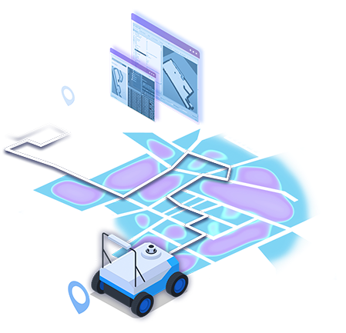

Software Development for Intelligent Autonomous Vehicles
ROS Navigation in 5 Days
FOR BUSINESSAUTONOMOUS PATH PLANNING FOR MOBILE ROBOTS
Oz Rotshtain 213746712
Adir Shachri 209135599
01

Slide 2


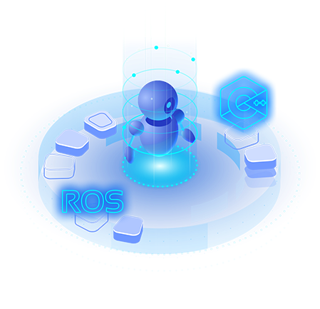
INTRODUCTION
The Robot Operating System (ROS) is an open-source framework that standardizes robotics software development by providing essential libraries, communication tools, and hardware abstraction. It allows developers to integrate a wide range of sensors, actuators, and algorithms into modular robotic systems.
Navigation in robotics is a key capability that enables autonomous movement by combining perception, mapping, localization, and path planning. These processes allow robots to understand their environment, build and use maps, determine their own position, and safely plan routes to specific destinations. As a result, ROS is widely used in both industry and academic research for building, testing, and deploying reliable navigation solutions across various robotic platforms.

Slide 3


COURSE OBJECTIVES
Gain a solid understanding of the ROS framework and its role in robotic software development.
Learn how to set up and configure the ROS navigation stack for both simulated and real robots.
Develop the ability to build and utilize 2D maps for robotic navigation using SLAM techniques.
Acquire practical skills in robot localization, enabling accurate position estimation within a mapped environment.
Master the principles of autonomous path planning and obstacle avoidance in dynamic settings.

Slide 4
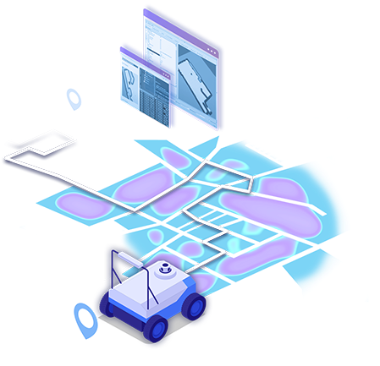
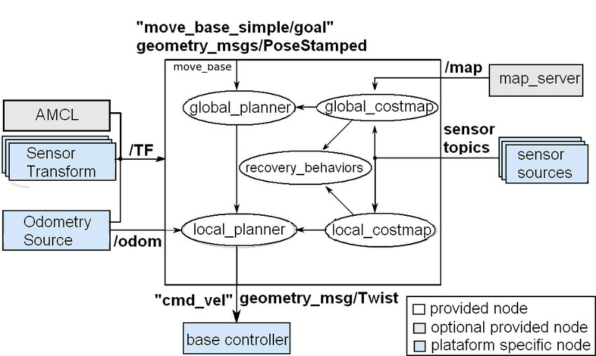




OVERVIEW OF THE ROS NAVIGATION STACK
The ROS Navigation Stack is a collection of software packages that enables autonomous movement for mobile robots. It integrates key components such as mapping, localization, path planning, and motion control into a unified system. The stack utilizes essential ROS packages like move_base, amcl, and map_server to process sensor data, generate environment maps, estimate the robot’s position, and compute safe paths to target destinations. By combining these modules, the ROS Navigation Stack allows robots to navigate complex environments efficiently and reliably.
Conducting In-depth Market Research
Collecting Demographic and Psychographics Data
Leveraging Customer Feedback and Reviews

Slide 5
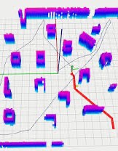


MAPPING THE ENVIRONMENT (SLAM)
Mapping the environment is a critical first step in autonomous navigation. Simultaneous Localization and Mapping (SLAM) algorithms enable robots to construct a map of an unknown environment while simultaneously estimating their own position within it. Using sensor data such as LIDAR or depth cameras, SLAM methods like gmapping or cartographer create detailed 2D maps that serve as the foundation for navigation tasks. Accurate mapping is essential for reliable localization and path planning, especially in dynamic or unfamiliar settings.

Slide 6

ROBOT LOCALIZATION
Robot localization refers to the process of determining a robot’s precise position and orientation within a known map. Reliable localization is essential for accurate navigation, as it allows the robot to understand where it is and plan movements accordingly. In ROS, localization is commonly achieved using adaptive Monte Carlo Localization (AMCL), which employs sensor data and probabilistic algorithms to continuously update the robot’s estimated position. Effective localization ensures that navigation remains robust even in changing or dynamic environments.

Slide 7


PATH PLANNING ALGORITHMS
Path planning algorithms are responsible for computing safe and efficient routes from the robot’s current location to its target destination. In ROS, global planners such as Dijkstra’s and A* generate overall routes using the map, while local planners like the Dynamic Window Approach (DWA) adjust the path in real time to avoid obstacles. These algorithms use costmaps to represent the environment and ensure that the robot can reach its goals without collisions. Effective path planning is essential for autonomous navigation in complex and dynamic spaces.

Slide 8

AUTONOMOUS NAVIGATION WORKFLOW IN ROS
The autonomous navigation workflow in ROS involves several sequential steps that enable a robot to move safely and efficiently in its environment. The process begins with generating a map of the surroundings, followed by localizing the robot’s position within that map. Next, navigation goals are set, and the path planning modules compute routes to these targets while avoiding obstacles. Throughout execution, the robot continuously updates its position and adjusts its movements based on real-time sensor data. This integrated workflow allows for reliable and adaptable autonomous navigation in dynamic settings.

Slide 9

HANDS-ON IMPLEMENTATION
Set up the ROS navigation stack on real or simulated robots.
Configure launch files and adjust navigation parameters for optimal results.
Integrate key sensors such as LIDAR, wheel encoders, and IMU for accurate mapping and localization.
Use RViz and rqt_graph to visualize robot data, monitor system status, and debug issues.
Practice iterative testing and parameter tuning to achieve reliable autonomous navigation.

Slide 10


CHALLENGES AND BEST PRACTICES
Dynamic environments
Robots must adapt to moving obstacles and changing layouts in real time.
Sensor limitations
Noisy or inaccurate sensor data can affect localization and mapping quality.
Parameter tuning
Achieving optimal navigation performance often requires careful adjustment of numerous settings.
Recovery behaviors:
Implementing robust strategies for error recovery improves reliability in unpredictable scenarios.
Simulation and real-world testing:
Combining both methods helps identify and resolve issues before deployment.
Regular map updates:
Keeping maps current ensures accurate localization and safe navigation as environments evolve.

Slide 11
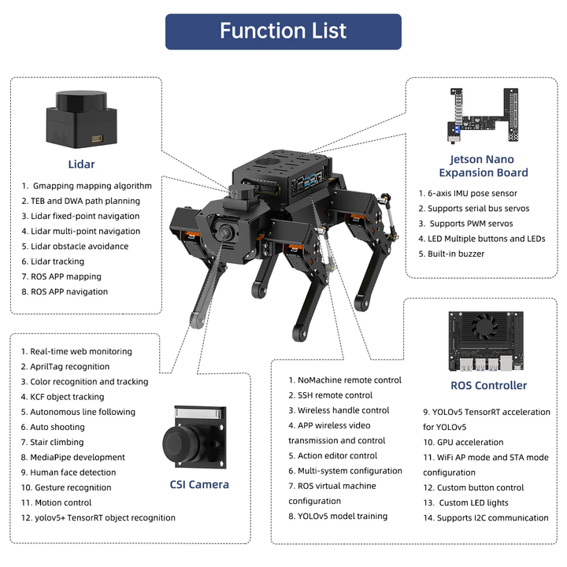

APPLICATIONS AND CASE STUDIES:
ROS navigation is widely applied across a variety of real-world domains. In warehouse automation, autonomous mobile robots use ROS to transport goods efficiently through complex environments. Domestic robots, such as robotic vacuum cleaners and lawn mowers, rely on navigation algorithms for safe and effective operation in homes and gardens. Delivery and service robots use ROS navigation to autonomously deliver packages and supplies in urban areas and hospitals. Additionally, research institutions leverage ROS for prototyping and evaluating advanced navigation techniques, while principles from ROS navigation are also foundational for the development of self-driving vehicles and drones.

Slide 12
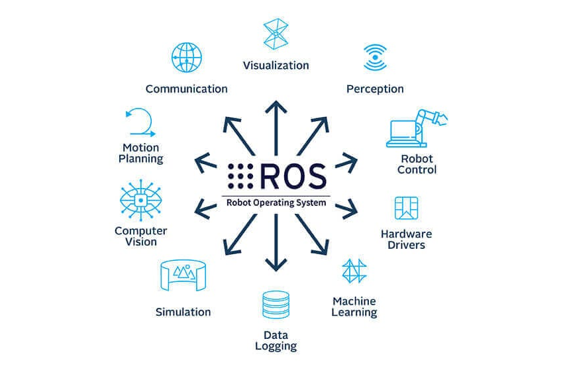
CONCLUSION & FURTHER LEARNING:
In conclusion, mastering ROS navigation provides the foundation for developing autonomous robots capable of perceiving their environment, localizing themselves, and planning safe paths. This course has introduced the essential concepts, tools, and practical skills needed for real-world navigation tasks. To further enhance expertise, students are encouraged to explore advanced topics such as multi-robot systems, 3D mapping, and robust sensor fusion. Continuous hands-on experimentation and engagement with the ROS community will deepen understanding and support ongoing growth in the field of robotics.

